Slide 1
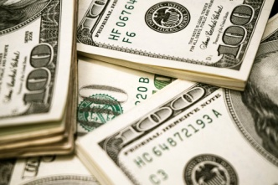
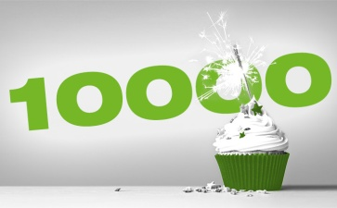
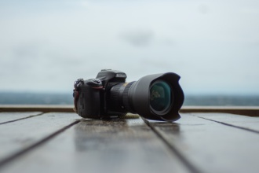
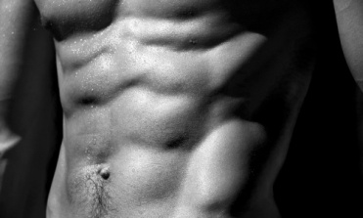
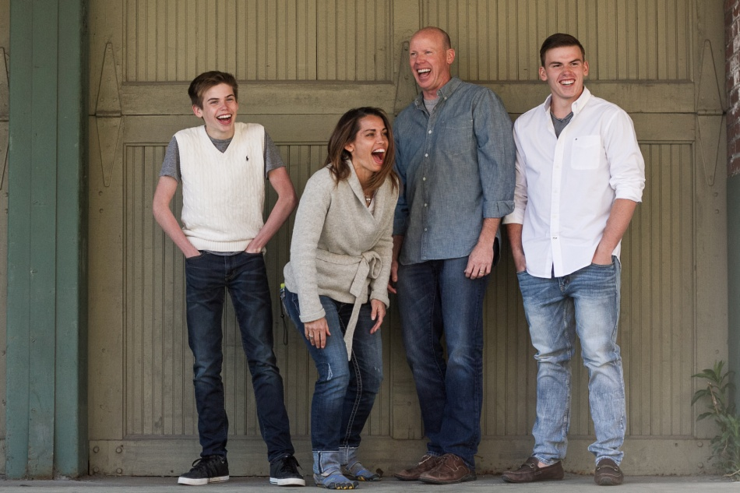
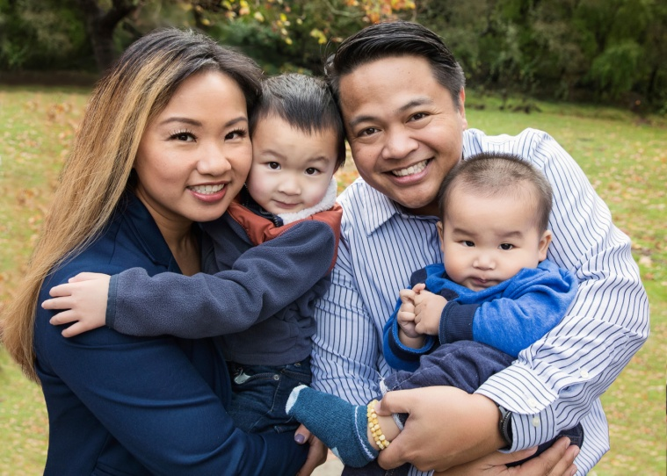
TOWARDS
2019
Double my Income
$200,000 (minimum)
ꚙ
10,000 books sold
(minimum)
ꚙ
Photography OWNER
(no longer an operator)
ꚙ
Visible 6-Pack Abs
AWAY
PRESENCE
HELPLESSNESS
Intentional Meditation / Awareness of my breathe / Notice the color of someone’s eyes / Feels someone’s emotions / Feeling the air in my lungs / Awareness of my inner joy / Feel the # of blinks I take / Am in an observant state
Only if I were to consistently believe in the illusion that I am incapable of taking any actions or there is no option, instead of remembering that choices are abundant and I was blessed with the ability see many choices.
UNDERSTANDING
SELF-PITY
Fee someone’s emotion / Hear what they’re saying and can repeat it back / Feel at peace with the information I take in / Present w/ others / Smile during a conversation
Only if I were to consistently focus on the illusion that I’m a victim of circumstances, instead of remembering that I control my life by controlling my meanings, emotions, & states.
PLAYFUL
The Purpose of My Life is to be PRESENT, LOVING & KIND, enjoy LAUGHTER + CONNECTION,
and do my
VERY BEST to SHOW UP for MYSELF & OTHERS!
Laugh / Smile / Say a joke / See others laugh / Dance / Connect with someone in joy
SELF-DOUBT
Only if I were to consistently focus on the stupid, fucking lie that I’m incapable of taking action and growing, instead of remembering that I show up for anything that is meaningful to me and that I make it fucking happen!
ALIVE
Actively move my body for at least 5 min / Fuel my body with energy-charged foods / Experience a meditative state for more than 1 min / Feel energy flow through my body / laugh with others / connect with others
JUDGEMENT OF OTHERS
Only if I were to consistently focus on the illusion that I’m better than others and that I know more than others, instead of remembering that we are all masters of what we focus on and that I have more to learn and room to grow!
INTELLEGENCE
A foundation & space of LOVE, CONNECTION, TRUST, VULNERABILITY & TRUTH
Make an observation / Am present with others / Create more than 2 possibilities for any situation / Listen to my heart to guide me / Can laugh at a situation I don’t prefer / Am in a high energy state / Am connecting with another person / Learning from another person
MY POWER VIRTUES
JOY
WEALTH
WHICH OPTION(S) WILL LEAD ME TO MORE LOVE, CONNECTION, GROWTH & CONTRIBUTION?
GRATITUDE
TRUTH

